Slide 1
Microwave Devices E511
Lecture 6
Amr Al.Awamry

Slide 2
Agenda
S matrix .. Cont.
Shift in Reference Planes
Power Waves and Generalized Scattering Parameters
THE TRANSMISSION (ABCD) MATRIX

Slide 3
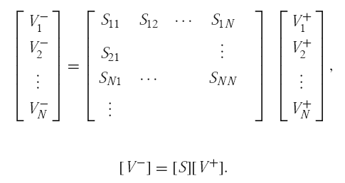
S matrix .. Cont.
Plz check in ref. for details

Slide 4
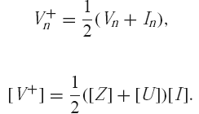
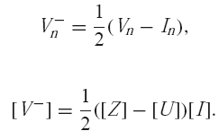
S matrix .. Cont.

Slide 5
S matrix .. Cont.
Lossless Network

Slide 6
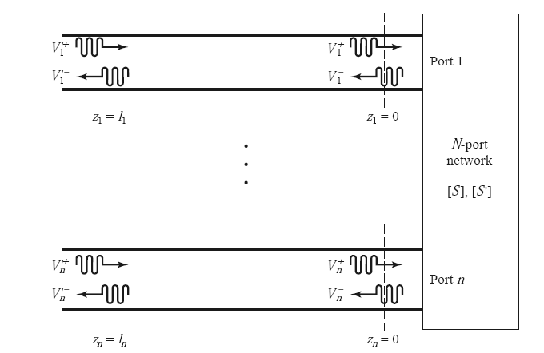
Shift in Reference Planes

Slide 7
Shift in Reference Planes cont.

Slide 8
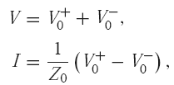
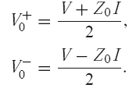
Power Waves and Generalized Scattering Parameters

Slide 9
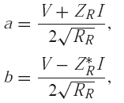
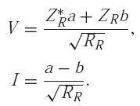
Power waves

Slide 10
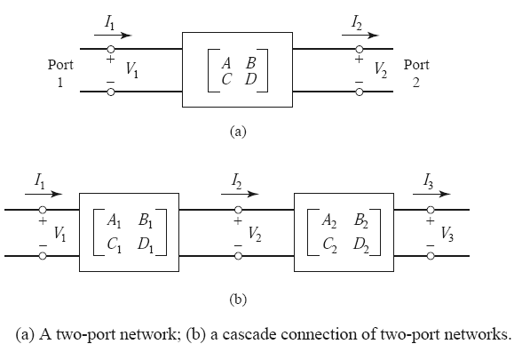
THE TRANSMISSION (ABCD) MATRIX

Slide 11
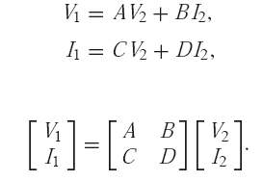
THE TRANSMISSION (ABCD) MATRIX ….. Cont.

Slide 12
